Slide 1
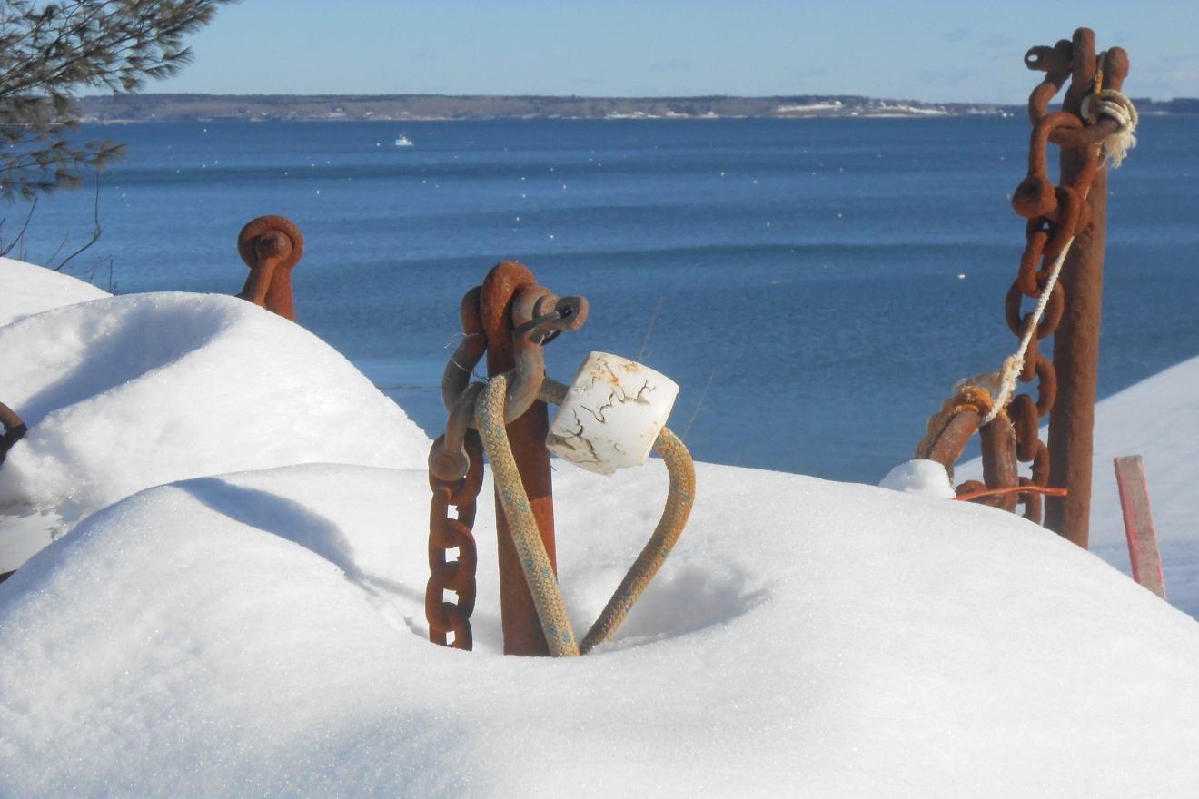
Mooring System Design Factors
Mooring System Design Factors
Single Point Recreational Marine
Novabraid Feb. 2013

Slide 2
System Components
Always design around Lowest Max. Working Load limit
Element | Options | Connection | Function
Anchor | Block, Mushroom, Helix, Dor-Mor | Gravity, Friction, Suction | Resistance
Catenary | Chain, Elastic, Weighted Line | Shackle, Thimble with spliced eye | Shock Load & Energy Absorption
Scope | Chain, Line, Cable | Swivel Shackle, Thimble with spliced eye | Accommodate water depth
Buoy | Poly ball, Spar, Hard Shell Float, etc. | Swivel, Shackle, Thimble with spliced eye | Buoyancy
Pendant | Spliced line with eyes, thimble, chafe, floats etc, | Shackle, Thimble with spliced eye, pear loop, etc. | Connection to vessel, load balance
Notes:
Hold up “Cat Line” weight and Elastic Down Line as non - traditional Cattanary

Slide 3
Rope Constructions
Commonly used in pendants
Three Strand Twisted | Nylon, Polyester, Polyolefin
12 Strand Hollow Braid | Nylon Polyester, Polyolefin, UHMPE (Spectra or Dyneema)
Double Braid | Nylon, Polyester cover – Nylon core, Polyester, Polyester Cover – UHMPE core
Notes:
Hold up examples to show

Slide 4
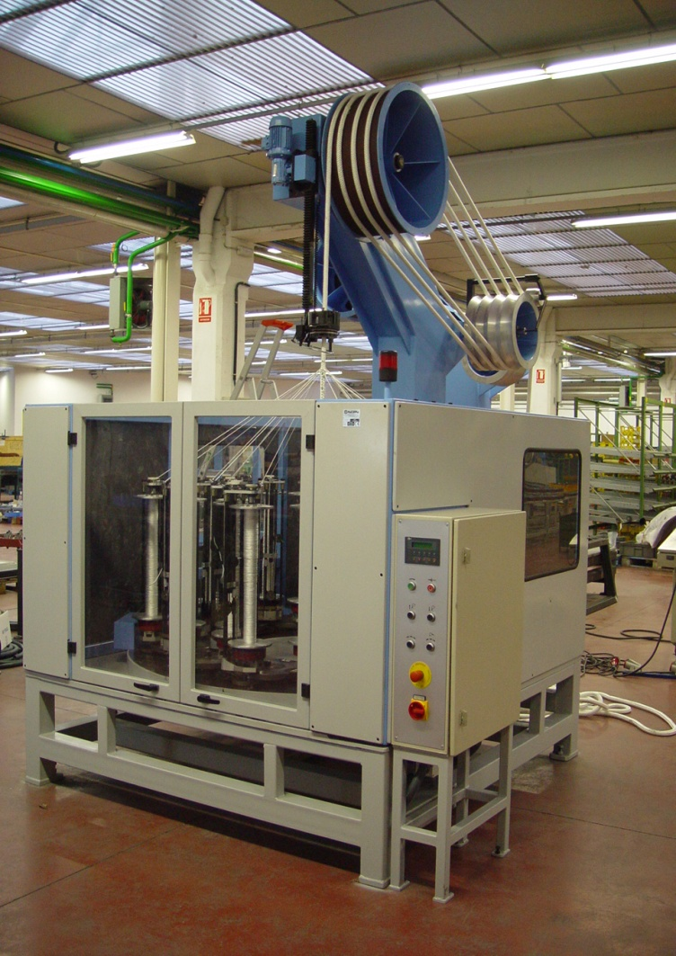
Rope Construction
Comparison
Construction | Advantages | Disadvantages
Three Strand Twisted | Low Cost Ease of Splicing | Can Hockle Soft Lay can Snag
12 Strand Hollow Braid | Low Torque Ease of Splicing | Soft Lay can Snag
Double Braid | Cover protects core from cut, abrasion, and UV | Higher Cost More difficult splice No Core inspection
Notes:
Pass around – examples
Discuss Twisted vs. braided manufacturing process tons per man hour / feet per shift.

Slide 5
Yarn Comparison
Material | Advantage | Disadvantage
Nylon | Energy Absorption, Shrink | Water Absorption, Wet Strength Loss, Sinking
Polyester (Dacron) | No water absorption, UV Resistance, Abrasion resistance | Sinking
Polyolefin (Polysteel) | Floating, No Water Absorption | Less UV Resistance
UHMPE (Spectra or Dyneema) | Highest Strength, Abrasion Resistance | High Cost, UV Resistance

Slide 6
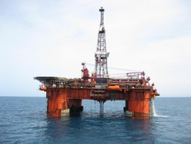
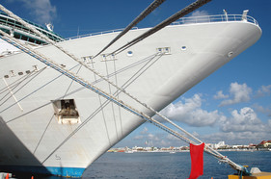
Energy Absorption vs. Wet Durability
Nylon
Polyester
Notes:
Traditionally, nylon lines have been used in LONG ship mooring lines because of their energy absorbing capacity. This is probably why some town mooring regulations require nylon pendants. Research has shown however that polyester out performs nylon in off shore mooring lines.

Slide 7
Relative Performance
7/8 Dia. x 15 Ft Pendants
Construction | Material | LD | Lbs. Dry Strength | Lbs. Wet Strength | WL | Stretch At WL | Retail Cost
3 Strand | Nylon | 20 | 20,000 | 18,000 | 3,600 | 19” | $ 70
 | Polyolefin | 16 | 18,780 | 18,780 | 3,750 | 8” | $ 60
Hollow Braid | Polyolefin | 14 | 15,800 | 15,800 | 3,160 | 5” | $ 100
 | UHMPE | 20 | 97,000 | 97,000 | 19,500 | 4” | $ 350
DBL Braid | Nylon | 22 | 28,000 | 25,200 | 5,000 | 19” | $ 120
 | Nylon / PE | 23 | 28,000 | 25,200 | 5,000 | 18” | $ 180
Better | Polyester | 24 | 26,300 | 26,300 | 5,250 | 9” | $ 150
Best | UHMPE/PE | 24 | 50,000 | 50,000 | 10,000 | 4” | $ 250

Slide 8
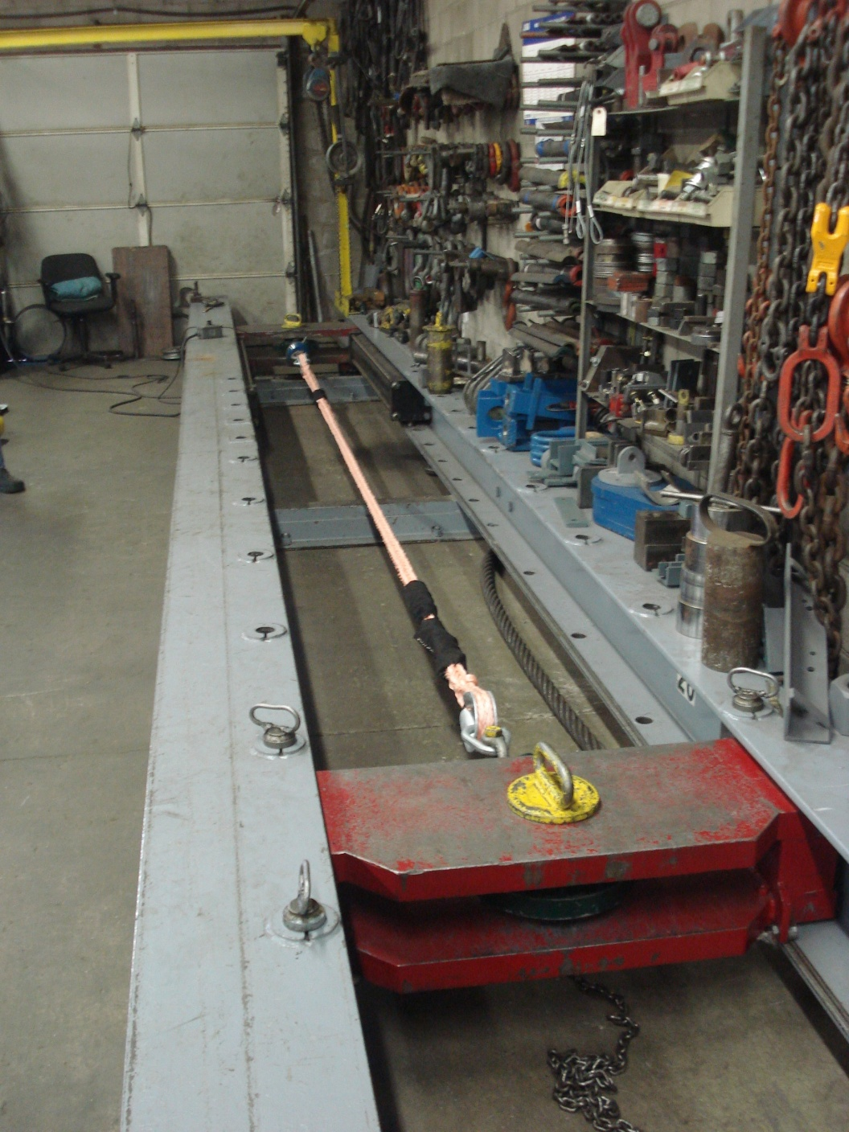
Tensile
Load Testing
Load testing is performed to Cordage Institute and ASTM standards.
Min. Break = Avg.
less 10%
Third Party Cert.
Tests include pre-tensioning
Lines not rated for shock loading

Slide 9
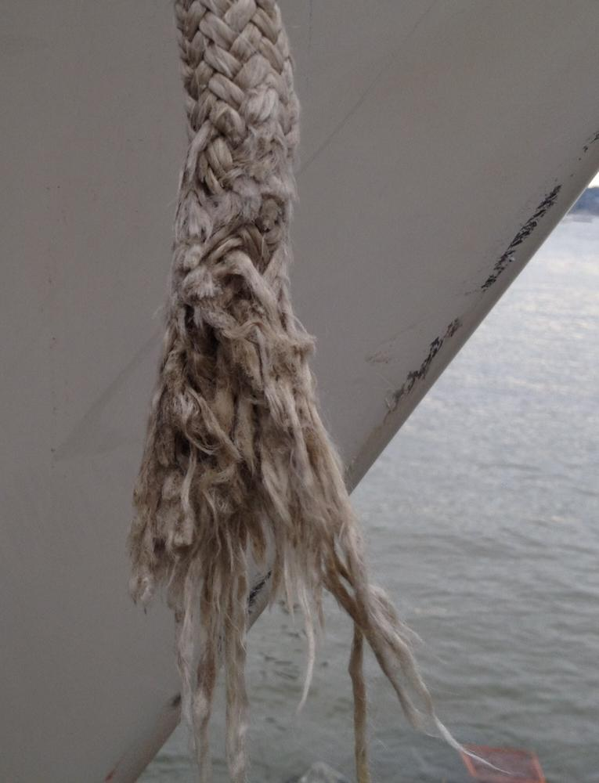
Shock Load ?
Anchor Chafe ?
Each wave 6’ x 6’ x 1’ or 36 cu ft of water weighs 2885 lbs
If traveling at 10 knots or 16.13 ft / sec.
A wave could generate 46,535 lbs per sq in per second load on a mooring pendant line.
http://www.pbase.com/mainecruising/mooring_prep
Notes:
Hold up example of tensile test sample with fused strands

Slide 10
Common Pendant Configurations
Configuration | Description | Application
Single | Soft Eye Boat End Thimble Buoy End | Keel Boats or Deep V Hull with Little Yaw
Double V | Two Singles of same length Joined with Thimbles in Common Pear Loop | Boats with small chocks, Fly Bridge and or Yaw
Double L | Two Single Pendants of Different Lengths | Back up strength – Sequential Loading

Slide 11
Novabraid Pendant Options
Stainless Thimbles – More Durable but will increase corrosion of adjacent non stainless hardware.
Coated Thimble Eye – Minimize gear chafe
Urethane Coating Line – Improves UV resistance and wash ability but will wear off.
Chafe Sleeve - Fixed – A must in chocks but also useful on buoy end to protect from barnacles and chain wrap.
Chafe Sleeve – Movable – Hook & Loop version great for anchor, dolphin striker, or other gear chafe.
Floats – Can make pick up easy and prevent chain wrap
Bitter End – Instead of Soft Eye for V leg length adjustment
Keeper Line – Secure eye on cleat or tall boy attachment
Notes:
Show Examples

Slide 12
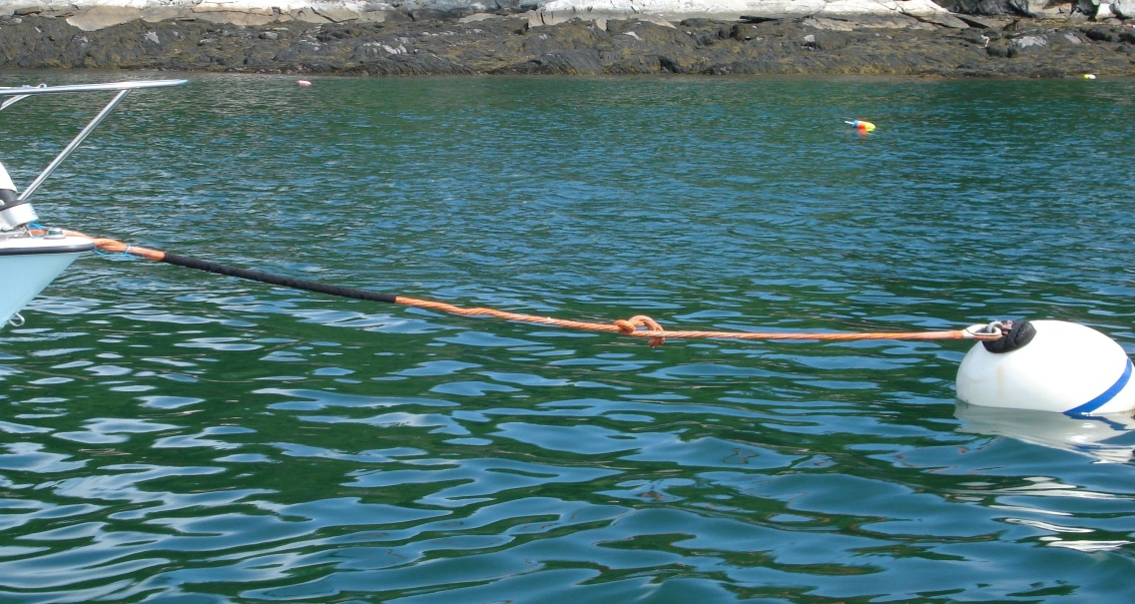
Dangerous Practices
Minimum Pendant length should be 4 x the rail to water surface height.
Knots may reduce new pendant line tensile strength by as much as 50%
Swivels are critical to prevention of line torque and strength loss.
Pendant lines should never be subject to excess bend radius.
“Bending radius for all lines natural or synthetic should be no less than four times the diameter of the rope” Handbook of Ocean & Underwater Engineering – John J. Myers
Notes:
Hitches on rings violate both the knot and bend radius warning

Slide 13
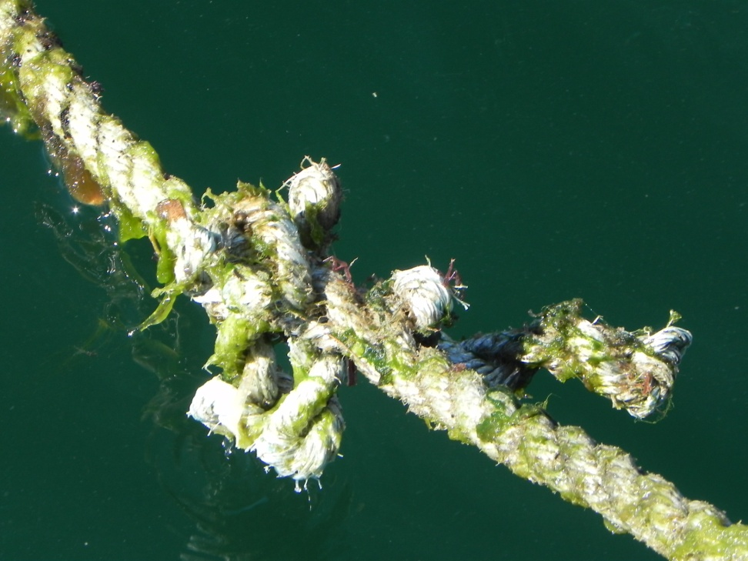
Pendant Care
Inspect for chafe, cut strands, torque, and thimble corrosion.
Remove growth with dull edge under tension
Remove for winter storage – soak / rinse in warm water – dish detergent – bleach
Hang to dry
Store indoors in mesh bag
Notes:
Hold up pendant in mesh storage bag

Slide 14
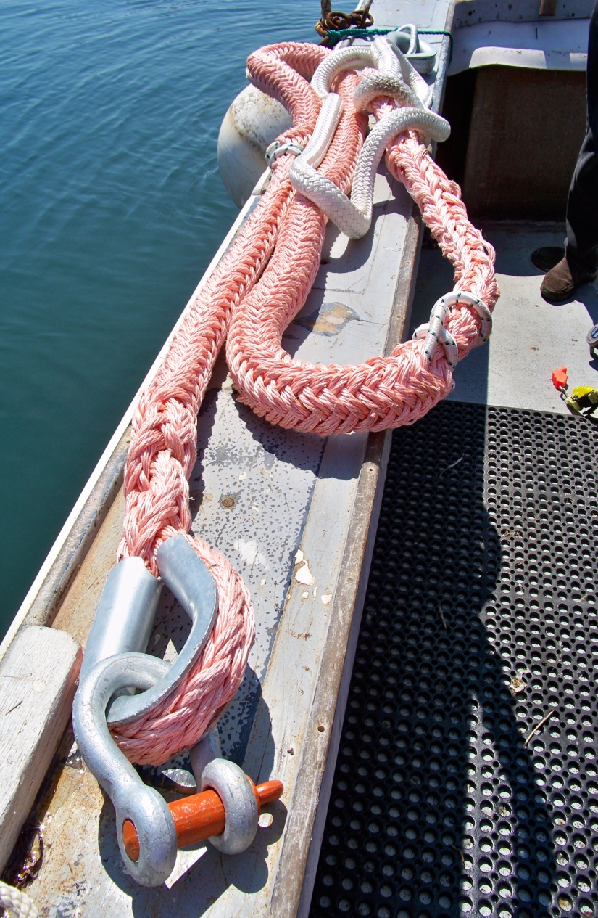
Mooring System Inspection
Visually Inspect all components annually
Replace worn, corroded or over loaded chain, line & fittings regularly
Record check list of each component’s condition & replacement schedule.
Include inspector’s sign off
Notes:
Hand out sample inspection sheet

Slide 15
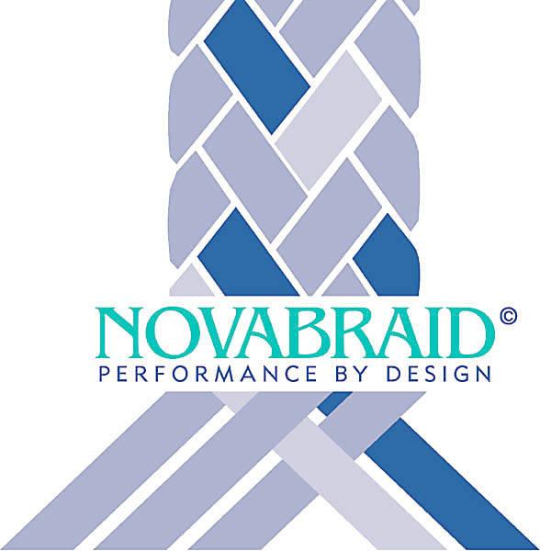
www.novabraid.com

